Slide 1

Dynamic mode decomposition
111061590 林學謙

Slide 2
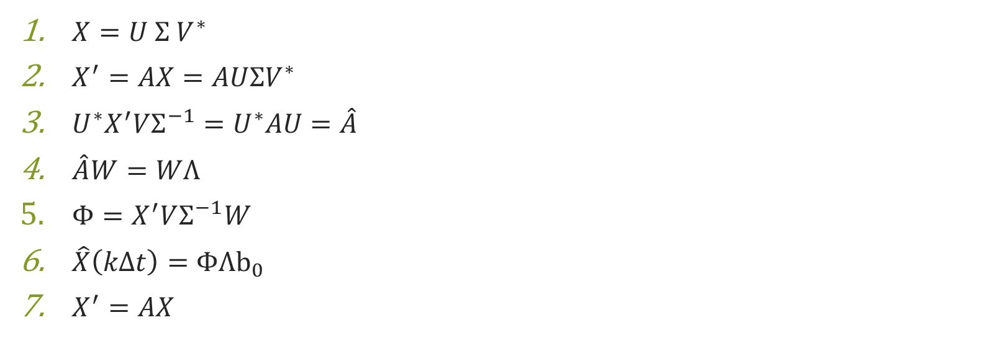
Dynamic mode decomposition function
$X=U Σ V^{∗}$
$X^{′}=AX=AUΣV^{∗}$
$U^{∗}X^{′}VΣ^{−1}=U^{∗}AU=\hat{A}$
$\hat{A}W=WΛ$
$Φ=X^{′}VΣ^{−1}W$
$\hat{X}\left(kΔt\right)=ΦΛb_{0}$
$X^{′}=AX$

Slide 3
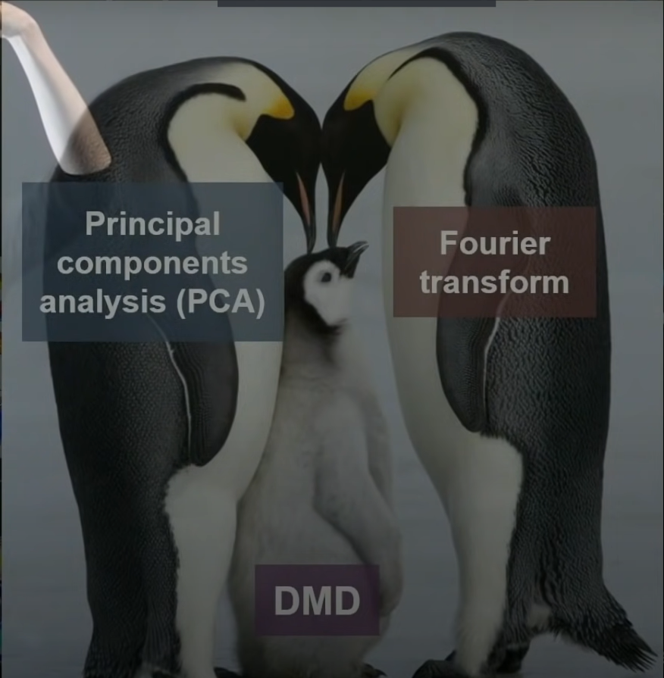
Conclusion

